Slide 1
By 2016, > 50% of mobile apps will be hybrid.
Why?
Gartner

Slide 2


SEEING THE FOREST FOR THE TREES BUILDING FULLY FEATURED Hybrid MOBILE APPS
Matt Netkow
The SAVO Group
@dotNetkow
netkow.com

Slide 3
Agenda : seeing the forest
My Mobile App & Background
Why Hybrid?
Building an app
Web
Native
Performance
Key Takeaways

Slide 4
My mobile app & background

Slide 5



Journey to mobile app
An idea emerges…
+
=
Fitbit user
Weight Watchers member
Fitwatchr
Desired Outcome:
Challenging calorie tracking
Available for multiple platforms
Charge for the app
Fast development cycles
Results:
Initial version created in days
Available for iOS, Android, and Windows Phone 8
Price varies: from $0.99 to $2.99
Over 10,000 paying users in 1 year

Slide 6
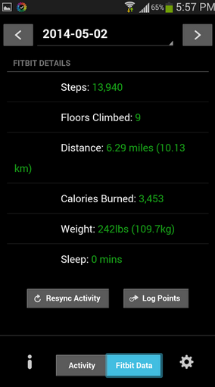
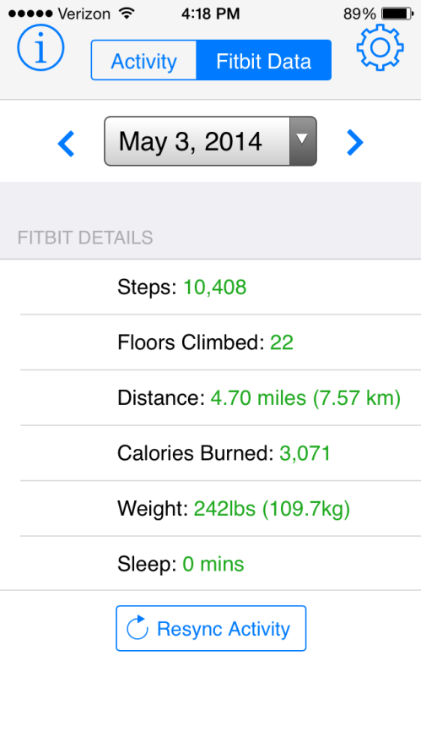
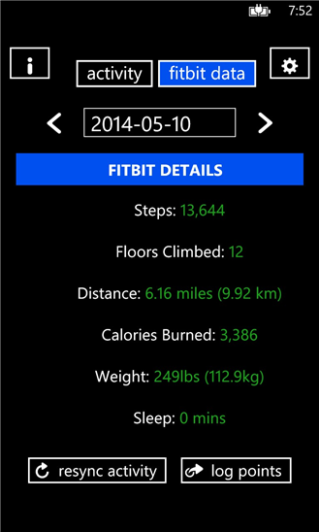
Fitwatchr versions
Android iPhone Windows Phone

Slide 7
About me
Senior Developer for The SAVO Group – 5 years
Sales Productivity SaaS
Backend .NET C# development: user/document automation, tools
Mobile app development for Netkosoft – 1 year
Focus on front-end development
Entirely PhoneGap-based, Hybrid apps
Team of Two (Partnered with Graphic Designer)
Netkow.com Blog
Technology trends, programming, PhoneGap
Notes:
This underlines that I was able to use my existing skills to create a hybrid app without learning extra languages.

Slide 8
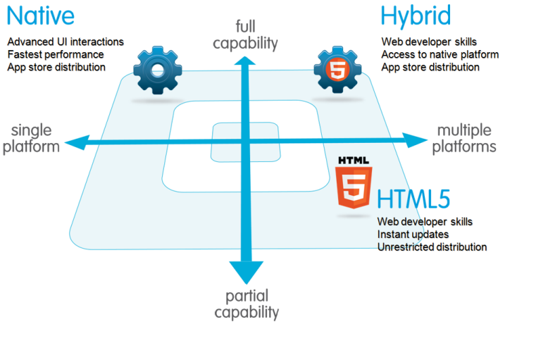
Which technology to use?
Salesforce.com

Slide 9
Why hybrid?

Slide 10
Why Hybrid? technology
Use existing HTML5, CSS3, JavaScript knowledge
Native optional! Objective C, Java, C#
Full Capabilities: Device APIs
Multiple Platforms: iOS, Android, Windows Phone

Slide 11
Why hybrid? business
Lower Cost
Single codebase
Single technology stack
Reuse business logic code
This matters because…
BYOD trend continues to gain momentum
Mobile/remote work is increasing across multiple industries

Slide 12
Why hybrid? individual
More opportunities: web technology usage increasing across devices
TV, cars, smart watches
Constantly getting better: tools, frameworks, lower barrier to entry
Career: developers who are strong in both frontend & backend are desirable

Slide 13
Creating a hybrid app

Slide 14
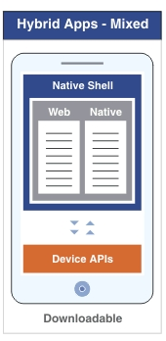
Creating a Hybrid app: Parts
1. Web:
All app logic (JavaScript)
Layout (HTML)
Styling (CSS)
2. Native Code & Native Shell:
WebView container
Compiled app
Device APIs
IBM
Notes:
In order to create an app, we have two major parts: Web and Native.

Slide 15
Creating a hybrid app: web

Slide 16
Web: javascript app logic
No surprises here!
Write JS normally
Classes, libraries, unit testing
Popular frameworks are compatible
Angular, Knockout, Backbone

Slide 17
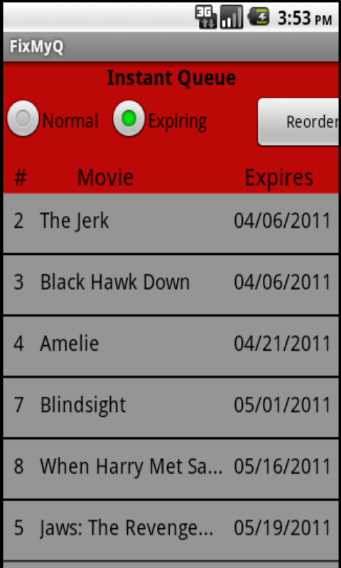
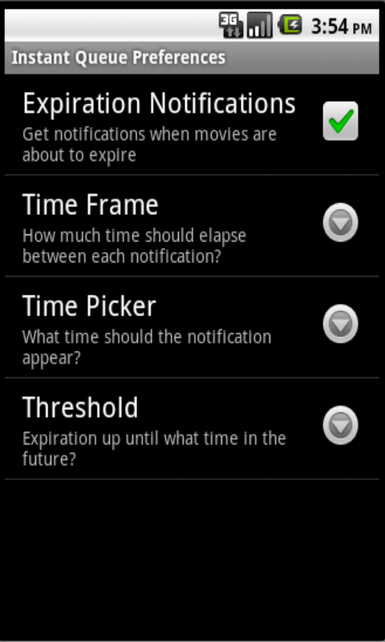
Web: layout & styling
Small mobile teams means understanding design is more important than ever!
An example:

Slide 18
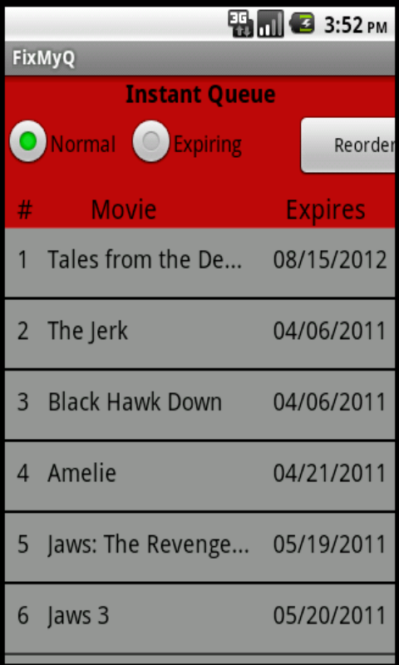
Web: layout & styling
Challenging to accomplish:
A native look
Touch friendly
Responsiveness
Phone:
Tablet:

Slide 19




Web: layout & styling The solution?
Let a mobile framework do the heavy lifting!

Slide 20
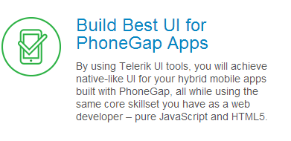


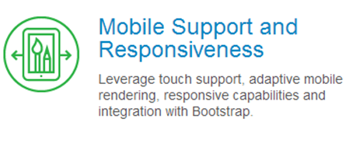
Kendo UI Mobile
KendoUI.com

Slide 21
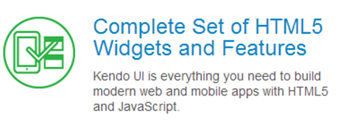
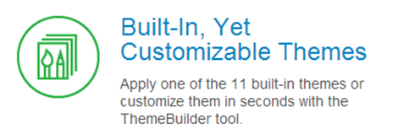

Kendo UI Framework
KendoUI.com
Demo
Notes:
KendoUI Mobile is part of the larger KendoUI framework suite

Slide 22
Responsive UI?
/* Phones */
@media only screen
and (min-device-width : 320px)
and (max-device-width : 480px) {
.img-round {
height: 40%;
width: 75%;
}
}

Slide 23
Responsive UI?
/* iPads/tablets */
@media only screen
and (min-device-width : 768px)
and (max-device-width : 1024px) {
.img-round {
height: 60%;
width: 80%;
}
}

Slide 24
Responsive UI?
/* Desktops and laptops ----------- */
@media only screen
and (min-width : 1224px) {
.img-round {
height: 20%;
width: 40%;
}
}

Slide 25

Much better!
Before:
After:

Slide 26
Kendo ui: cost?
~$700, Early 2013
$199, Late 2013
Free/open-source, April 2014
Telerik

Slide 27
Creating a hybrid app: native

Slide 28
From web to native app
Notes:
How do we transform our web app into a native one?

Slide 29
From web to native app
PhoneGap
JS framework that implements native “wiring” for you
Provides access to device features via JavaScript API’s
Individual Platform SDKs required
PhoneGap Build
Cloud service that creates native app & injects PhoneGap into it
No SDKs, compilers, or hardware (iOS requires a Mac)
1 private app free, unlimited open source apps

Slide 30

phonegap build: features
Plugins
Fill in missing native functionality
Camera interaction
In-app Browser
Google Analytics
Hydration
Automatically deploy new app versions to devices
Use individually or with a team
Remote debugging
Review app code, storage, etc. all in real-time
Debug plugin behavior
demo

Slide 31
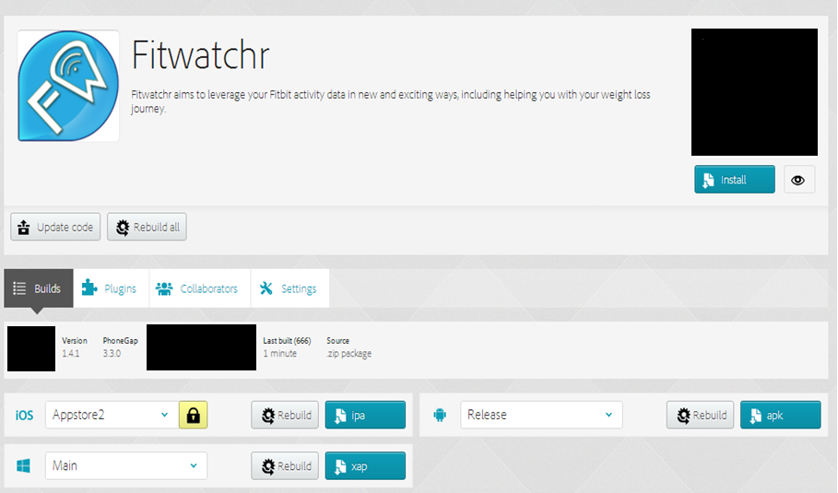
Phonegap build site
No Internet
Notes:
First, you zip up your code and upload it here. The Build service starts running, takes only a few minutes tops. All selected app platforms are here. You can download each compiled app, and load it onto a device.

Slide 32
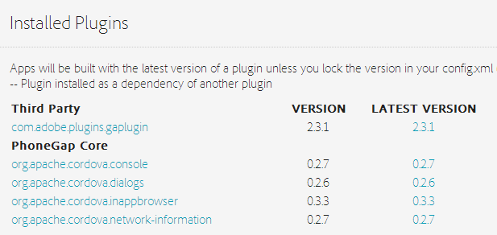
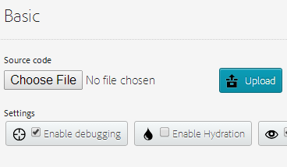
Phonegap build site
No Internet

Slide 33
Creating a Hybrid app: recap
Web:
All app logic (JavaScript)
Layout (HTML)
Styling (CSS) via Kendo UI Mobile
Native & Native Shell:
Compiled app via PhoneGap Build
Device APIs: PhoneGap
Notes:
Using KendoUI Mobile, PG Build and PhoneGap we cover all the parts of a hybrid app!

Slide 34
Performance considerations

Slide 35
Hybrid app performance
Hardware: natural improvements over time; incredibly powerful phones now
Software:
iOS: big improvements between iOS 7 and 8 Javascript performance, 4.5x faster with new WebView; webGL adoption
Android: v4.4 has new WebView version based on Chromium
Windows Phone 8: IE10-based WebView
May never be the exact same as native - consider what is “good enough” for your app
Apple

Slide 36
Key takeaways

Slide 37

Key takeaways: App recommendations
Business:
Keep existing server side code for heavy processing, reusability (Xamarin, C#)
Consumer/Social/Integrations:
Short to mid-range calculations
Web APIs
Simpler Games: WebGL, Canvas
Complex Games: It depends…

Slide 38
Key takeaways
“By 2016, > 50% of mobile apps will be hybrid.”
Expand your Web development skills
Create beautiful UIs
KendoUI Mobile
Build for all devices
PhoneGap Build

Slide 39
Get building!
KendoUI source
PhoneGap Build
PhoneGap Build Starter Template
This Presentation: PPTX and code

Slide 40

Questions?
Matt Netkow
www.netkow.com
@dotNetkow
matt.netkow@gmail.com

Slide 41











That conference sponsors
Notes:
Thanks to our Principal, Platinum and Gold Sponsors.

